Slide 1

Spark Machine Learning Binary Classification with the Titanic Dataset
Rich Tarro February 23, 2017
Big Data Architect
rtarro@us.ibm.com

Slide 2
Spark ML Pipeline Terminology
Spark ML standardizes APIs for machine learning algorithms to make it easier to combine multiple algorithms into a single pipeline, or workflow
DataFrame: Spark ML uses DataFrame from Spark SQL as an ML dataset, which can hold a variety of data types
Transformer: A Transformer is an algorithm which can transform one DataFrame into another DataFrame
Estimator: An Estimator is an algorithm which can be fit on a DataFrame to produce a Transformer
Pipeline: A Pipeline chains multiple Transformers and Estimators together to specify an ML workflow
Parameter: All Transformers and Estimators share a common API for specifying parameters

Slide 3
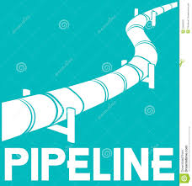
Pipelines – How they work
A Pipeline is specified as a sequence of stages where each stage is either a Transformer or an Estimator
These stages are run in order and the input DataFrame is transformed as it passes through each stage
For Transformer stages, the transform() method is called on the DataFrame
For Estimator stages, the fit() method is called to produce a Transformer (which becomes part of the fitted Pipeline), and that Transformer’s transform() method is called on the DataFrame
For example, a simple text document processing workflow might include several stages:
Split each document’s text into words
Convert each document’s words into a numerical feature vector
Learn a prediction model using the feature vectors and labels

Slide 4

Demo Data - Titanic
The binary classification demo will utilize the famous Titanic dataset https://www.kaggle.com/c/titanic/data
The Titanic data set was chosen as it contains text based and numeric features that are both continuous and categorical, giving us the opportunity to explore and utilize a number of feature transformers available in Spark ML

Slide 5

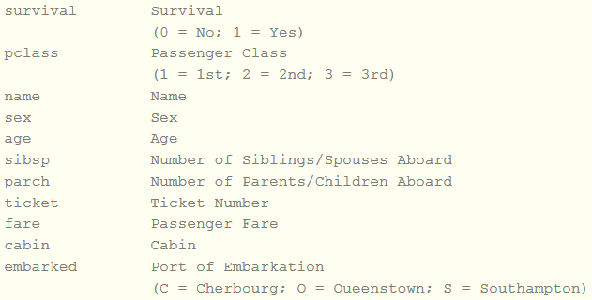
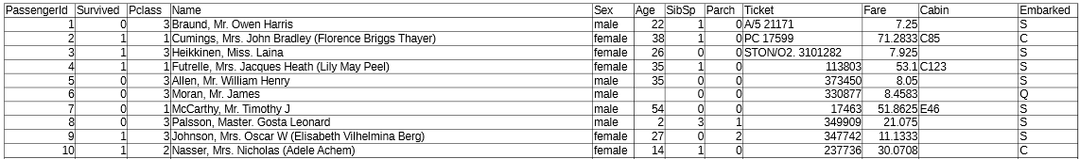
Demo Data - Titanic
Variable Descriptions:

Slide 6

Demo Flow
Read in Titanic dataset as a DataFrame
Drop unwanted columns and rows with null or invalid data
Label the data (“Survived”)
Feature Engineering
StringIndexer (Sex and Embarked variables)
Bucketizer (Age and Fare variables)
VectorAssembler
Normalizer
Create a Pipeline
Split Ratings data into Training (90%) and Test (10%) datasets
Cache the resulting DataFrames
Fit the Pipeline to the Test data set
Logistic Regression

Slide 7

Demo Flow (continued)
Evaluate the resulting predictions
Area under the ROC curve
Tune the model (hyperparamaters)
Build Parameter Grid
Cross-evaluate to find the best model
Make improved predictions using the cross-validated model
Make prediction on an imaginary passenger
Show how to easily reuse completed work using a different machine learning algorithm
Random Forest

Slide 8


Slide 9

Backup

Slide 10


